Slide 1

Clustering of Countries for Strategic Aid Allocation
A Data-Driven Approach to Identify Countries in Need of Aid

Slide 2
Problem Statement
Business Problem
GIVE Foundation is an international humanitarian NGO working to reduce poverty and provide support to underdeveloped countries.
Recently, the organization raised $10 million through funding programs. The CEO needs to determine which countries should receive priority aid.
However, identifying the countries most in need is challenging due to:
Differences in economic development
Variation in health conditions
Multiple socio-economic indicators
Goal
Use data-driven analysis to categorize countries based on development indicators and identify those in urgent need of aid.

Slide 3
Project Objective
Objective of the Analysis
The objective of this project is to identify countries that require urgent humanitarian assistance using clustering techniques.
Key goals:
Analyze socio-economic and health indicators of countries
Group similar countries using clustering algorithms
Identify the cluster representing least developed countries
Provide a final list of countries that should receive priority aid
This will help GIVE Foundation allocate the $10 million fund effectively and strategically.

Slide 4
Dataset Overview
The dataset contains socio-economic and health indicators of countries.
Total Countries: 167
Important variables used in the analysis:
GDP per capita (gdpp) – Economic productivity of a country
Income – Average income of citizens
Child Mortality (child_mort) – Number of child deaths under 5 years of age per 1000 births
Life Expectancy – Average lifespan of people
Total Fertility Rate – Average number of children per woman
Health – Healthcare investment
These indicators help measure the overall development level of each country.

Slide 5
Analysis Approach
The following steps were performed to complete the analysis:
Data Inspection and Data Cleaning
Exploratory Data Analysis (EDA)
Outlier Analysis
Feature Scaling / Standardization
Clustering Model Implementation
K-Means Clustering
Hierarchical Clustering
Cluster Evaluation and Interpretation
Identification of Countries Requiring Aid
This structured approach helped convert raw data into actionable insights.

Slide 6
Exploratory Data Analysis (EDA)
Exploratory Data Analysis was performed to understand the patterns in the data.
Key observations:
Countries with high GDP and income generally have low child mortality
Countries with low GDP and low income tend to have higher child mortality
Strong relationship observed between economic development and health indicators

Slide 7
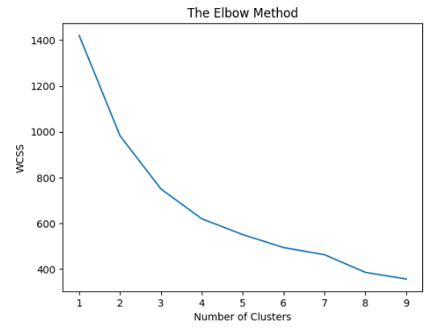
Choosing the Number of Clusters
To determine the optimal number of clusters, the Elbow Method was used.
The Elbow Curve showed that the optimal value of K = 3.
This means the countries can be grouped into three distinct clusters based on development levels.
Clusters represent:
Developed countries
Developing countries
Underdeveloped countries

Slide 8
Clustering Models Used
Two clustering techniques were applied:
K-Means Clustering:
Groups countries based on similarity in their socio-economic indicators
Efficient for large datasets
Provides clear cluster separation
Hierarchical Clustering:
Builds clusters step by step
Uses dendrogram to visualize relationships between countries
After evaluation, K-Means Clustering provided clearer and more interpretable clusters and was used for the final analysis.

Slide 9
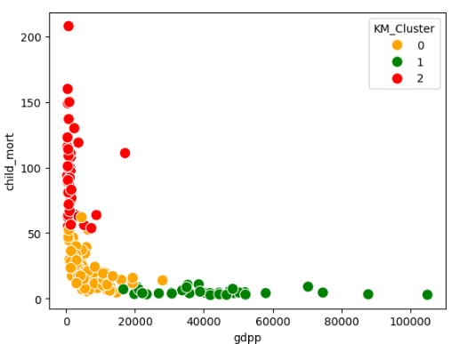
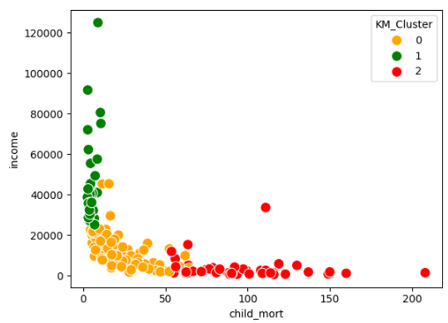
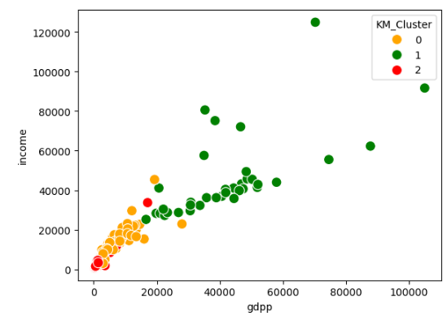
Cluster Visualization
Cluster visualizations were created using key
development indicators
Scatter plots were created for:
GDP vs Income
GDP vs Child Mortality
Income vs Child Mortality
These visualizations clearly showed distinct
groups of countries based on development level.
Countries with Low GDP, Low income, High child mortality

Slide 10
Cluster Analysis
The clustering model divided countries into three groups.
Countries in Cluster 2 are identified as requiring immediate humanitarian aid.
Cluster | Characteristics | Development Level
Cluster 0 | Moderate GDP, moderate income | Developing Countries
Cluster 1 | High GDP, high income, low mortality | Developed Countries
Cluster 2 | Low GDP, low income, high child mortality | Underdeveloped Countries

Slide 11
Countries Identified for Priority Aid
Based on the clustering analysis, the following countries were identified as most in need of aid:
These countries show low economic development and high child mortality rates, indicating urgent need for support.
COUNTRY | GDPP | INCOME | CHILD_MORT
Haiti | 662 | 1500 | 208
Sierra Leone | 399 | 1220 | 160
Chad | 897 | 1930 | 150
Central African Republic | 446 | 888 | 149
Mali | 708 | 1870 | 137

Slide 12
Key Insights
Important insights from the analysis:
Economic indicators strongly influence health outcomes
Countries with low GDP and income suffer from higher child mortality
Clustering effectively grouped countries with similar development levels
A specific cluster of countries was identified as most vulnerable
Using data-driven methods helps reduce bias and improve aid allocation decisions.
Recommendations
Based on the analysis, the following recommendations are proposed:
Prioritize aid allocation to countries in the underdeveloped cluster
Focus investments on healthcare, nutrition, and child welfare programs
Support economic development initiatives in these countries
Monitor improvements using socio-economic indicators over time
This approach will help GIVE Foundation maximize the impact of the $10 million aid fund.

Slide 13
Conclusion
This analysis used clustering techniques to categorize countries based on socio-economic and health indicators.
The results successfully identified countries facing the most critical development challenges.
Using this data-driven approach allows GIVE Foundation to:
Make strategic funding decisions
Target aid to the countries that need it most
Ensure maximum humanitarian impact

